Slide 1




NEXT GEN EMPLOYABILITY PROGRAM
Creating a future-ready workforce
Team Members
College Name
Student Name : Jeffy . J
Student ID : au95122104014
J P College Of Engineering, Ayikudy.

Slide 2

CAPSTONE PROJECT SHOWCASE
Project Title
Voting Web Application using Django Framework
Abstract | Problem Statement | Project Overview | Proposed Solution | Technology Used | Modelling & Results | Conclusion

Slide 3
Abstract
The Voting Web Application using Django is a project aimed at developing a robust and user-friendly web application that facilitates the voting process.
The application leverages Django, a powerful Python-based web framework, to handle the backend operations, and utilizes HTML, CSS, JavaScript, and Bootstrap for creating an intuitive and visually appealing frontend.
The project aims to streamline the voting process, enhance security, and provide real-time results.

Slide 4
Problem Statement
Traditional voting methods often suffer from various challenges, such as long queues, logistical issues, and potential inaccuracies.
Additionally, managing and counting votes manually can be time-consuming and error-prone.
The objective of this project is to address these issues by developing an efficient and secure web application for conducting voting processes.

Slide 5
Project Overview
The voting web application allows users to register, log in, and cast their votes for different candidates or propositions.
The application provides a simple and intuitive user interface, making it easy for voters to navigate through the voting process.
The system ensures that each user can cast only one vote and maintains the secrecy and integrity of the voting process.

Slide 6
Proposed Solution
.
The proposed solution is to develop a web application using Django, a high-level Python web framework known for its simplicity and versatility.
Django provides a robust backend infrastructure, including user authentication, database management, and request handling.
HTML, CSS, JavaScript, and Bootstrap are utilized to design an attractive and responsive frontend, ensuring a seamless user experience.

Slide 7
Advantages
Django for web applications offers rapid development, scalability, strong security features, an supportive community, versatile capabilities, an ORM for data base interactions, built-in admin interface, reusable components, SEO-friendliness, and a mature, stable frame work.
web applications is its extensive built-in features and batteries-included approach, which reduces the need for external dependencies and simplifies development by providing all the essential tools within the frame work itself.
Django is versatile and can be used to build a wide range of web applications, from simple blogs to complex e-commerce platforms, including voting systems.

Slide 8
Disadvantages
For a voting web application, one disadvantage of using Django could be the need for real-time updates or live data synchronization, which might require additional configuration or third-party tools as Django is primarily designed for request-response model rather than real-time data handling.
Voting web application is the potential for scalability challenges, especially if the application experiences sudden spikes in traffic during voting periods. Managing and scaling the application to handle increased load may require additional resources and expertise.

Slide 9


Technology Used
Front-end
Back-end

Slide 10
Modelling & Results
The system architecture follows the Model-View-Controller (MVC) pattern, with Django handling the model and controller components. The models define the database schema, including user information, candidates, and votes. The views handle user requests, perform necessary operations, and render dynamic web pages. The controllers manage the flow of data between the models and views.
The web application provides real-time updates on the voting results, allowing administrators to monitor the progress. The results are stored securely in a database, ensuring accuracy and reliability.

Slide 11
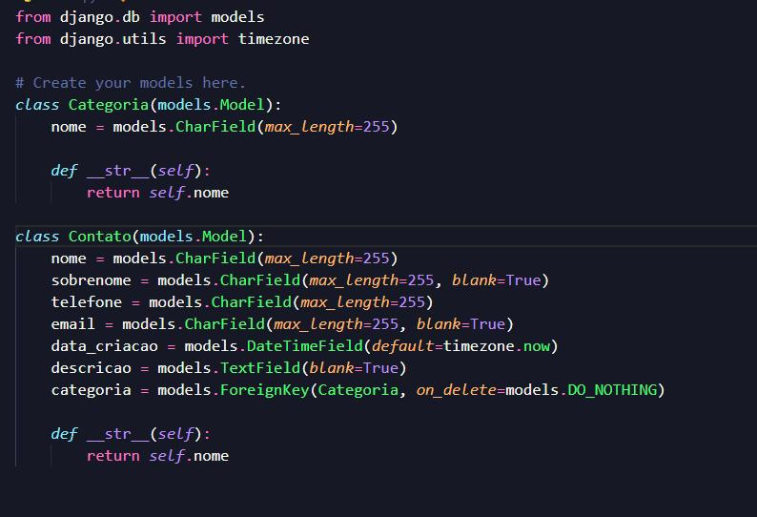
Homepage

Slide 12
About-Us-Page
1.Credibility: The "About Us" page establishes credibility by providing information about the organization's history, mission, and team members .
2.Mission and Values: It communicates the organization's mission, values, and objectives in promoting democratic participation and decision-making.
3. Community Engagement: The page showcases the organization's commitment to community engagement and empowerment through the voting process, inspiring active participation.
4. Contact Information: Users can easily reach out with questions, feedback, or inquiries about the voting application through the contact information provided on the page.

Slide 13
Service-Page
1.Header Section
2.Introduction section
3.User Services
4.Administrator Services
5.Organizational Services
6.Technical Services
7.Consulting Services
8.Call to Action Services

Slide 14
Departments-Page
Header Section
Introduction Section
Department Listings
Department Details
Key Personnel
Collaboration Opportunities
Footer Section

Slide 15
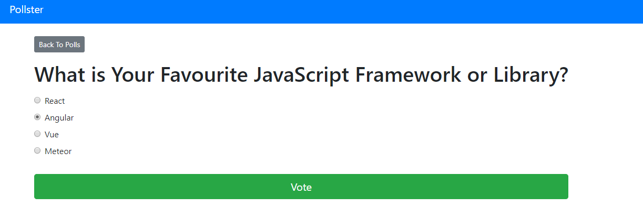
Blog-Page

Slide 16
Future Enhancements:
Utilize machine learning algorithms to analyze voting data, predict future trends, and provide personalized recommendations for users based on their voting history and preferences
Extend the voting application's reach by developing native mobile apps for iOS and Android platforms, offering a seamless and optimized experience for mobile users.
Explore integrating blockchain technology to enhance the transparency, security, and integrity of the voting process, ensuring that votes are immutable and tamper-proof.
Implement comprehensive reporting functionalities for administrators to generate detailed reports on voting patterns, demographics, and trends. This could include visualizations such as charts and graphs.

Slide 17
Conclusion
The Voting Web Application using Django offers an efficient and user-friendly platform for conducting voting processes.
By leveraging Django's robust features and incorporating modern frontend technologies, the application streamlines the voting process, enhances security, and provides real-time results.
This project demonstrates the potential of web-based solutions in revolutionizing traditional voting systems.

Slide 18
Thank You!
Notes:
Thank You !!

